Slide 1
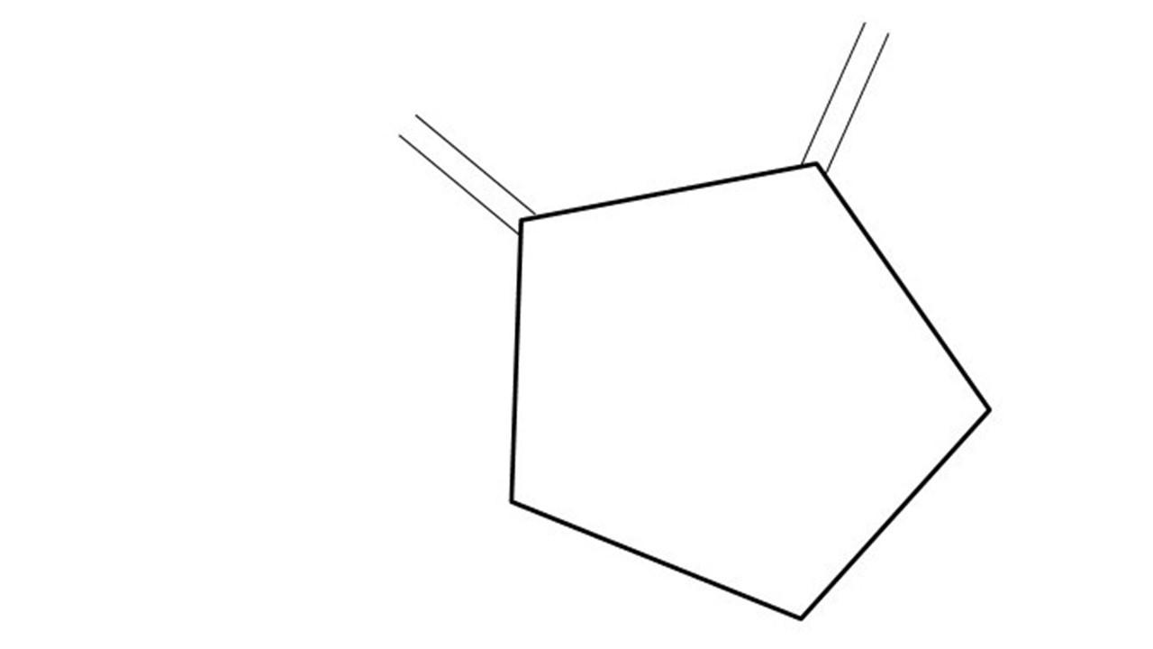
Great Cow BASIC Part 18
Great Cow BASIC for the PIC16F171xx chip Family
October 2022

Slide 2
Videos...
Install the hardware and make the board work – three LED programs
Make four LEDs flash in a sequence
Set the LEDs to represent the value of ADC
Sequence the LEDs with a delay using the value of ADC
Using an input to set the state of the LED
Using the reset switch
Using the switch, ADC – the LEDs flash in a sequence with reverse
Using the serial to display values
Using the timer0 overflow, 8bit timer, 16bit timer to flash the LEDs
Using CCP/PWM to dim the LEDS
Using I²C with serial to discover I2C devices
Using EEProm – showing values on the serial terminal
Using an I²C GCLD display
Using an SPI GCLD display
Using PWM to dim the LEDS
Using memory within the PIC – Progmem and SAF memory
The Great Cow BASIC tool chain
Assembly and alternatives assemblers
Summary

Slide 3
Great Cow BASIC Compiler
Great Cow BASIC is an Open Source compiler for Microchip PIC &AVR and Logic Green AVR microcontrollers
Great Cow BASIC now supports the 16F171xx chip family
Great Cow BASIC is a cross platform with common code translation
Great Cow BASIC Compiler

Slide 4
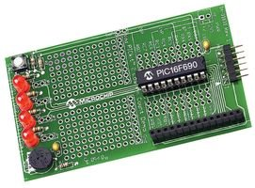
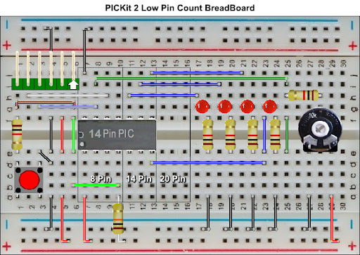

Hardware
Microchip Low Pin Count Demo Board
PICKit_2_Low_Pin_Count_User_Guide_51556a.pdf
By Chris Roper

Slide 5
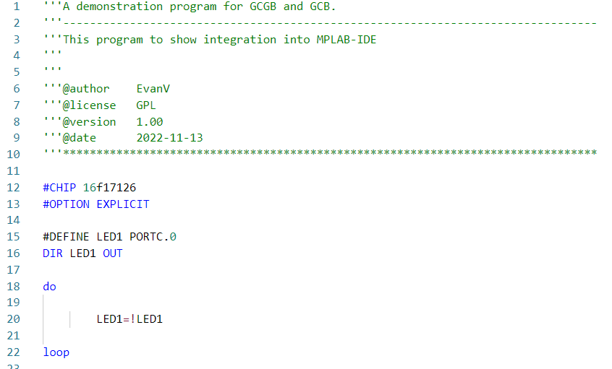
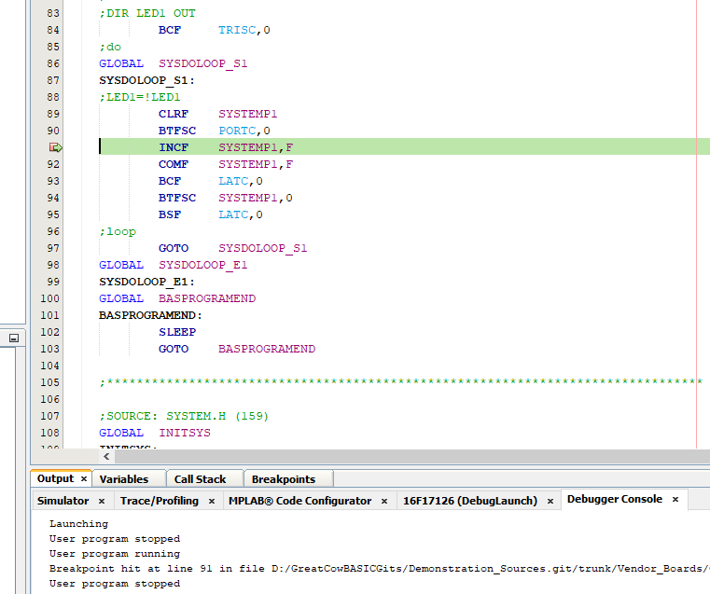
Great Cow BASIC & MPLAB-X/PIC-AS

Slide 6
The core compiler
High Level Language
Reports:
TXT and HTML
Source Code
Great Cow BASIC Compiler
Great Cow BASIC Compiler
Preprocessor
Code Translator
Assembler
Linker
Assembly Language
ASM file
Absolute Machine Code
HEX file
Libraries
8 bit PIC and AVR

Slide 7
Using MPLAB-X
High Level Language
Reports:
TXT and HTML
Source Code
PIC-AS,
MPLAB-IDE
Great Cow BASIC Compiler
Great Cow BASIC Compiler
Preprocessor
Code Translator
Assembler
Linker
Assembly Language
file
Absolute Machine Code
HEX file
Libraries
8 bit PIC and AVR

Slide 8
Lab
We will
Review a simple LED program
Create a Project in MPLAB-X using the Great Cow BASIC .S source
Select Standalone project
Specify chip, select the Simulator
Select PIC-AS, latest version
Name project {chipname}, specify same directory.
Finish
Now Add the Great Cow BASIC .S source file
Add existing to “Source Files” using the context menu
item/select source .S file with AUTO
Select the Project Properties
Set Conf:[default] Instruction Frequency to 64
Set Conf:[default] Building – check Execute this line after build to program chip
..\PICKitPlus\pickitcommandline.exe -w -p${Device} -f${ImagePath} -mpec -zv -a5
Press OK to save
Test compile <F11> and program
Use the debugger to walk the code

Slide 10
Videos...
Install the hardware and make the board work – three LED programs
Make four LEDs flash in a sequence
Set the LEDs to represent the value of ADC
Sequence the LEDs with a delay using the value of ADC
Using an input to set the state of the LEDs
Using the reset switch
Using the switch, ADC – the LEDs flash in a sequence with reverse
Using the serial to display values
Using the timer0 overflow, 8bit timer, 16bit timer to flash the LEDs
Using CCP/PWM to dim the LEDS
Using I2C with serial to discover I2C devices
Using EEProm – showing values on the serial terminal
Using an I2C GCLD display
Using an SPI GCLD display
Using PWM to dim the LEDS
Using memory within the PIC – Progmem and SAF memory
The Great Cow BASIC tool chain
Assembly and alternatives assemblers
Summary

Slide 11
Great Cow BASIC Part 18
Great Cow BASIC for the PIC16F171xx chip Family
October 2022

